Slide 1
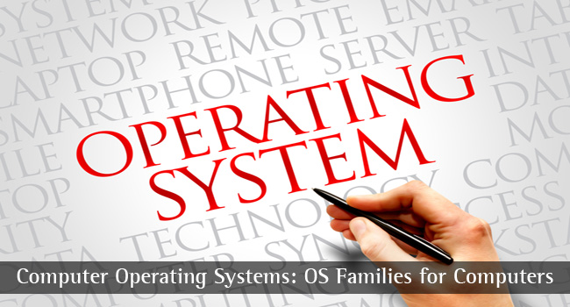
CS-3103 : Operating Systems : Sec-A (NB) : OS Architecture
Operating Systems

Slide 2
Introduction
Operating system architecture models are of three main types:
  Monolithic operating system
  Layered operating system
  Client–Server or microkernel operating system
Operating Systems

Slide 3
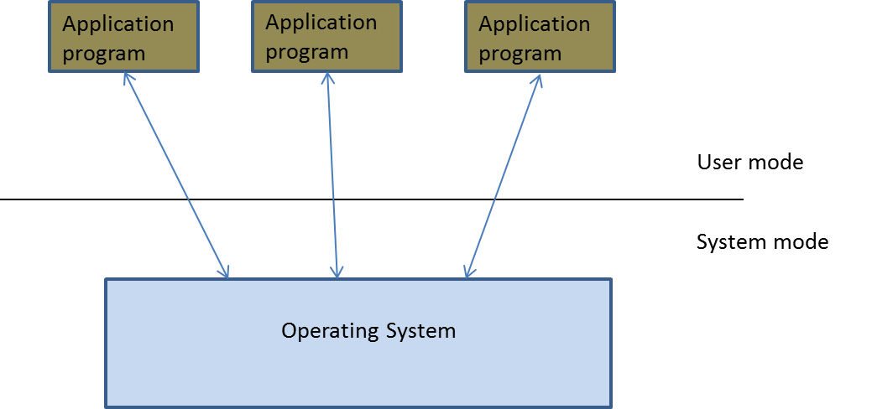
Processor Execution Modes
There are two modes of processor execution:
  User mode
  System mode
Operating Systems

Slide 4
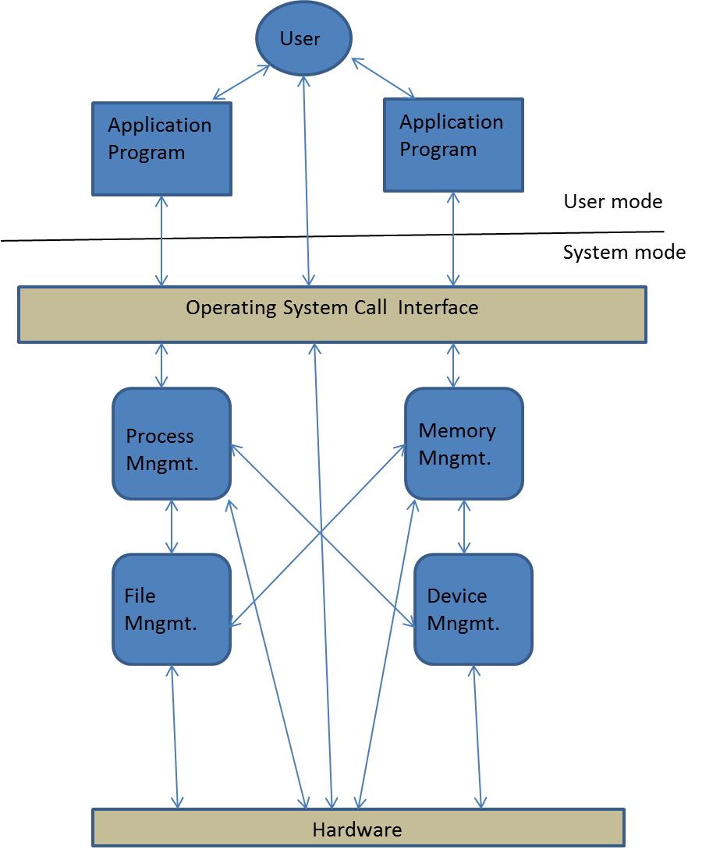
Monolithic Operating System
The OS is divided into procedures.
Example - MS DOS
Operating Systems

Slide 5
Advantages and Disadvantages of Monolithic Operating Systems
Advantages
  Efficiently manage the resources
  The code becomes efficient because of the smaller size of the OS.
Disadvantage
  The OS cannot handle procedures or components that contain errors.
Operating Systems

Slide 6
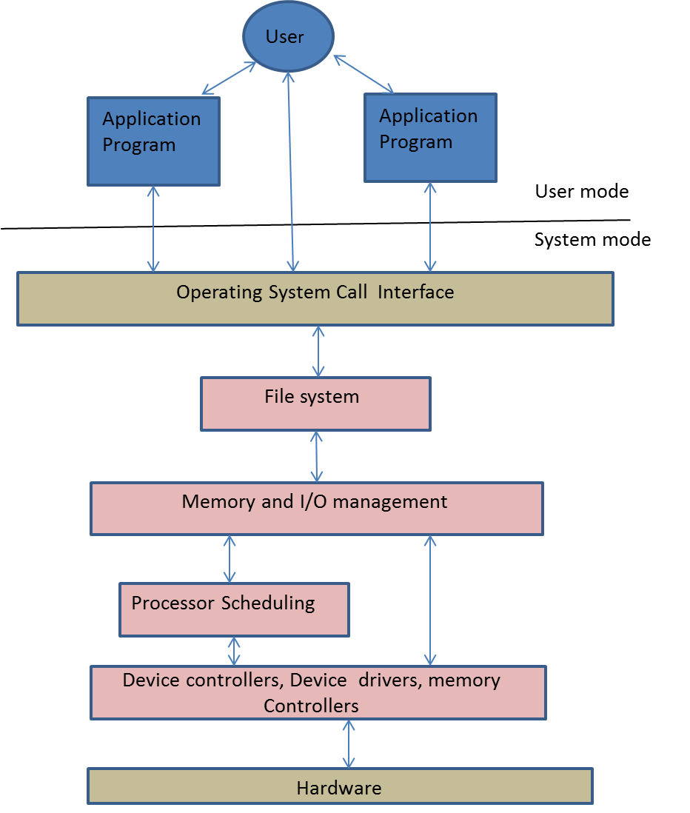
Layered Operating System
The various components are implemented as a collection of logical layers. Example: VAX/VAS and UNIX.
Layered operating system
Operating Systems

Slide 7
Advantages and Disadvantages of Layered Operating Systems
Advantages
  Each layer can be developed independently.
  The degree of portability is high.
Disadvantages
  System becomes slow.
  OS cannot handle a layer with errors.
Operating Systems

Slide 8
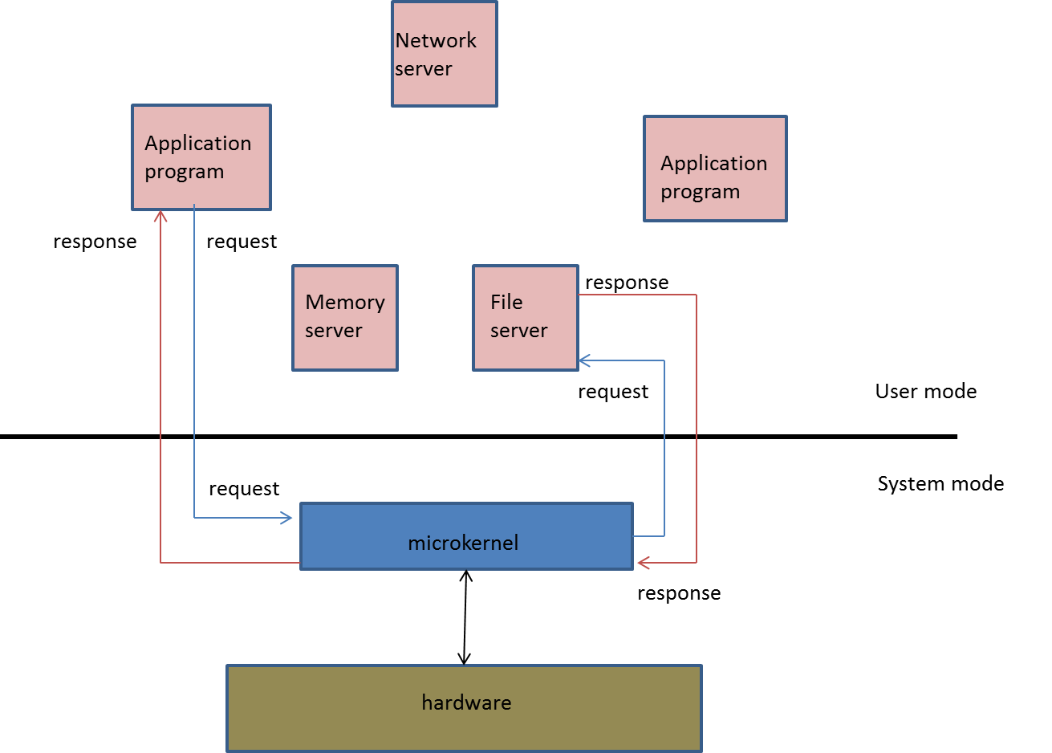
Microkernel Operating Systems
Designers separated the most essential components of an operating system in the form of a microkernel.
Microkernel operating system
Operating Systems

Slide 9
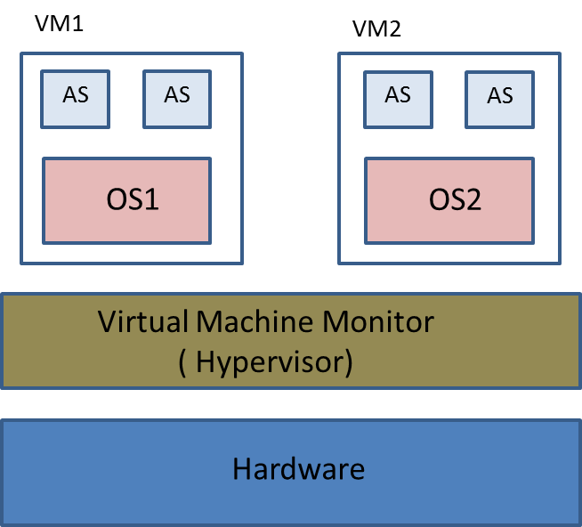
Virtual Machine Architecture
Virtualization can be defined as, “The process of creating multiple copies of an object”.
The software that creates multiple copies of a machine is called a Virtual Machine monitor or a hypervisor.
Example: IBM MVS/360, VMware, Xen, etc.
Virtual machines
Operating Systems

Slide 10
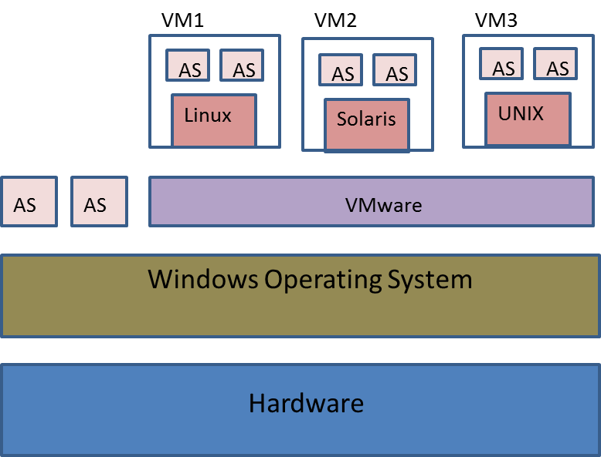
VMware Loaded on Windows OS
Operating Systems

Slide 11
Advantages and Disadvantages of Virtual Machines
Advantages
  Binary compatibility is achieved without making any changes to the application programs.
  No need to change the underlying operating system.
  A new version of an operating system can be tested for bugs.
Disadvantage
  Performance of the guest operating system becomes low.
Operating Systems

Slide 12
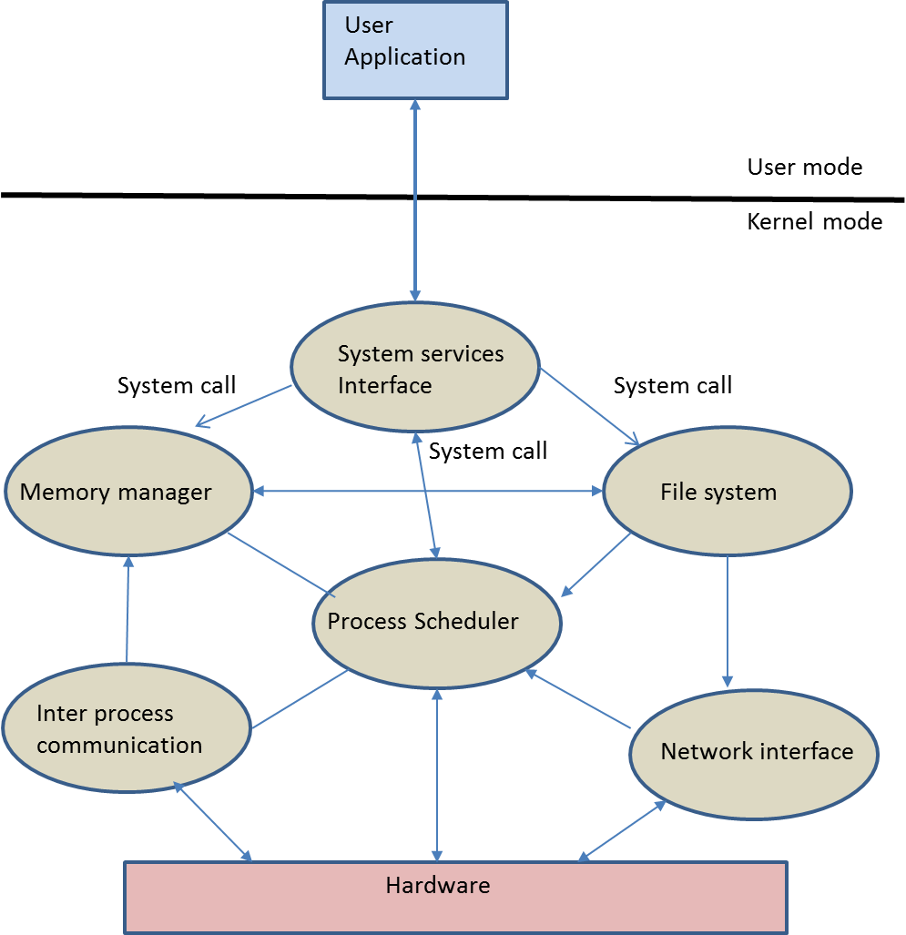
Linux Kernel Architecture
Linux is a monolithic architecture.
It consists of the following components:
  Process scheduler
  Memory manager
  File system
  Interprocess communication
  Network interface
Linux architecture
Operating Systems

Slide 13
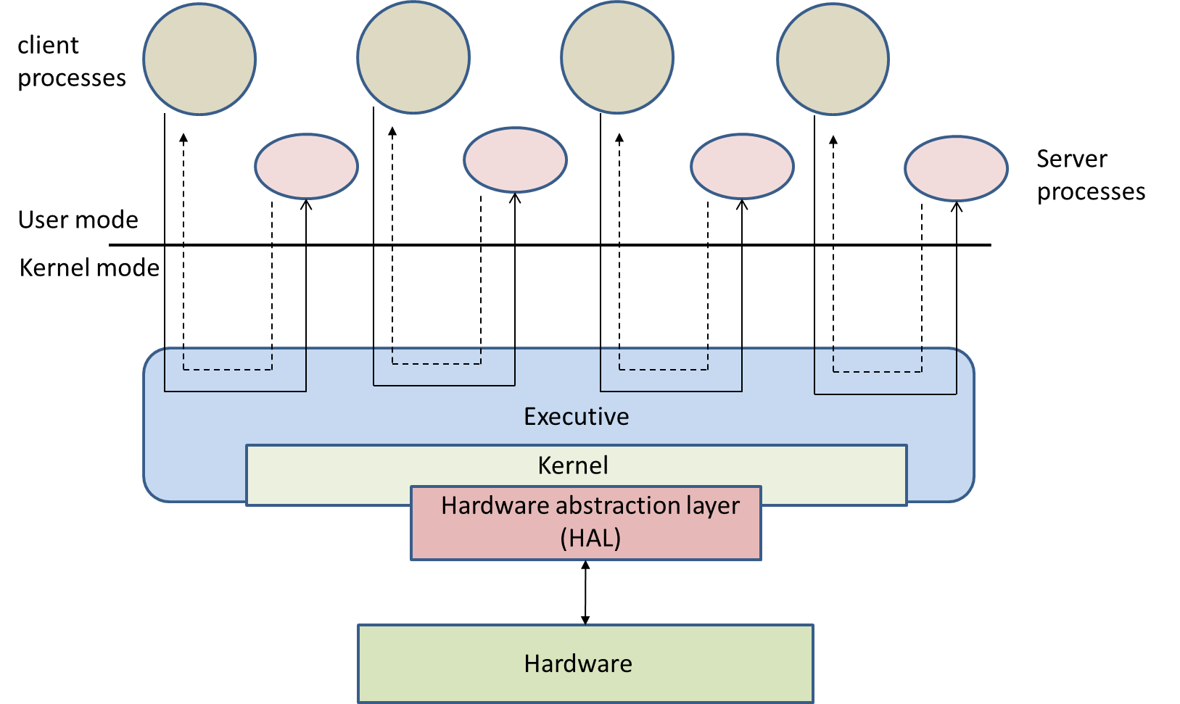
Windows Architecture
Windows OS is primarily a ‘client–server’ OS architecture
It is a hybrid of layered and microkernel architecture.
Windows operating system architecture
Operating Systems

Slide 14
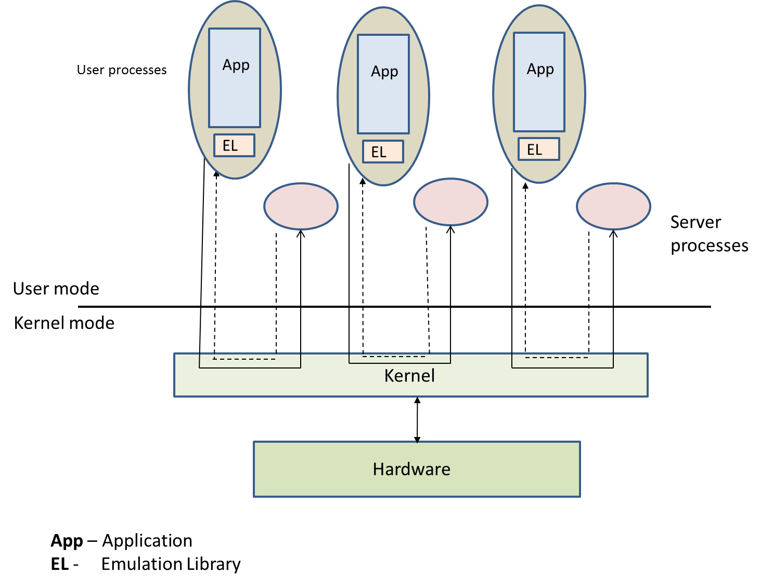
Mach System Architecture
It is a microkernel architecture consisting of three layers:
  Processes
  Server processes
  Kernel
Mach system architecture
Operating Systems

Slide 15
Mach System Architecture
The kernel performs the following functions:
  Task and thread management
  Inter-process communication
  Memory object management
  System call redirection
  Device support
  Multiprocessing
  Multi-computer support
Operating Systems

